Slide 1


Semantic Data Normalization
For
Efficient Medical Data Analysis
Todor Primov

Slide 2
History and Essential Facts
Started in year 2000
  As R&D lab within Sirma – the biggest Bulgarian software company
Got spun-off and took VC investment in 2008
  65 staff, HQ in Bulgaria, offices in London and Jersey City
Over 400 person-years invested in R&D
  Multiple innovation & technology awards: Washington Post, BBC, FT, BAIT, etc.
Member of multiple industry bodies: W3C, EDMC, ODI, LDBC, STI

Slide 3












Technology Excellence Delivered
Innovative technology mix: Graph DB engine + Text mining
Robust technology: We run BBC.CO.UK/SPORT and parts of FT.COM
We serve many of the most knowledge intensive enterprises

Slide 4
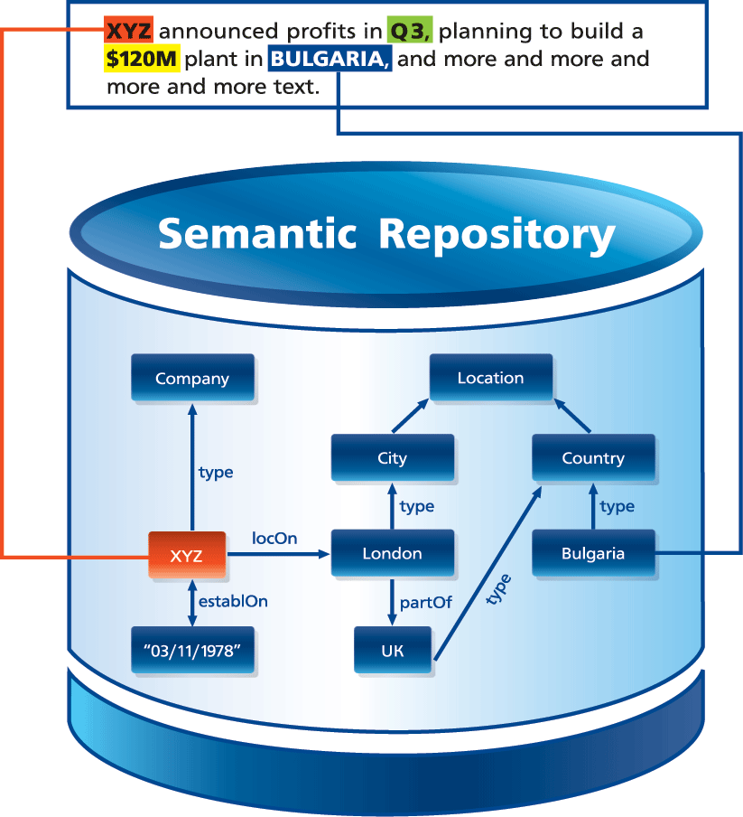
Our approach to Big Data
Integrate relevant data from many sources
  Build a Big Knowledge Graph from proprietary databases and taxonomies, integrated with millions of facts of Linked Data
Infer new facts and unveil relationships
  Performing reasoning across data from different sources
Interlink text and with big data graphs
  Using text-mining to discover references to concepts
Use NoSQL graph database for metadata management, querying and search

Slide 5
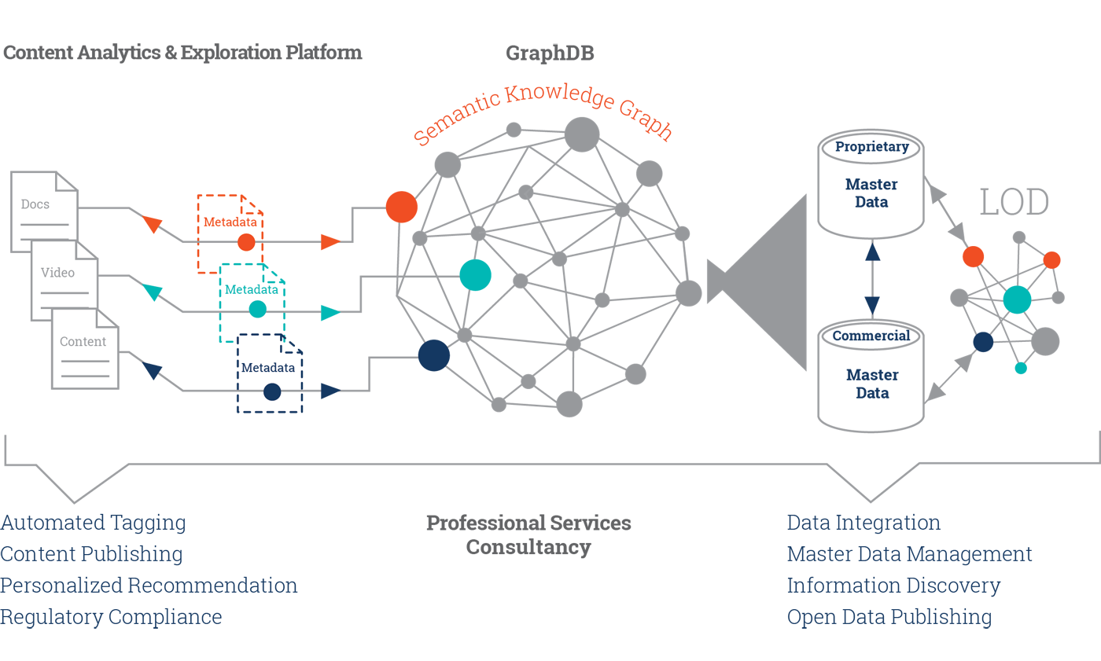

Slide 6
Applications in Healthcare and Life Sciences
Building a holistic view (Knowledge and Data Integration)
  Better Disease Understanding
  Next Generation Therapies, New Applications
Patient Stratification & Personalized medicine (not the same)
Connecting pre-clinical and clinical studies
  Translational Medicine
Detection of earlier (safety) signals
Ensuring medical and regulatory compliance

Slide 7
What is the Semantic Web?

Slide 8
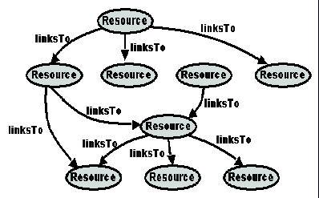
The Current Web
What the computer sees: “Dumb” links
No semantics - <a href> treated just like <bold>
Minimal machine-processable information

Slide 9
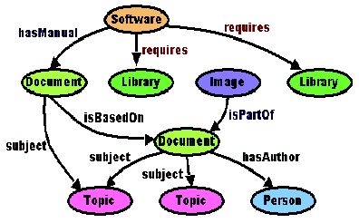
The Semantic Web
Machine-processable semantic information
Semantic context published – making the data more informative to both humans and machines

Slide 10
Semantic Web Tooling
A standard way of identifying things
A standard way of describing things
A standard way of linking things
Standard vocabularies for talking about things

Slide 11
The Semantic Web
Basic Standards for Describing Things
Richer structure for basic resources (XML)
Describe Data by Semantics and Not Syntax: RDF
Define Semantics using RDFS or OWL
Reference and Relate All Resources using URIs
SPARQL is super model of SQL
Rules for higher level reasoning

Slide 12
The Technologies: RDF
Resource Description Framework (RDF)
W3C standard for making statements or hypotheses about data and concepts
Descriptive statements are expressed as triples: (Subject, Verb, Object)
Subject
Property
Object
<Nitrazepam> <binds_to> <Sodium channel protein 1 subunit>

Slide 13
Facts as triples
has_associated_disease
PARK1
Parkinson disease
subject
predicate
object

Slide 14
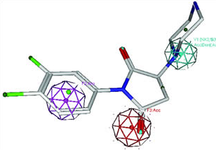
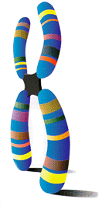
Data Silos
Patents
Tox
HCS
Biomarkers
Libraries
Targets
Assays
Genotypes
Diseases
EMR
EHR
Clinical
Trials

Slide 15
From triples to a graph
MAPT
Parkinson disease
Parkinson disease
MAPT
MAPT
Pick disease
Pick disease
PARK1
Parkinson disease
PARK1
Parkinson disease
TBP
Parkinson disease
Parkinson disease
TBP
TBP
Spinocerebellar ataxia
Spinocerebellar ataxia
has_associated_disease
MAPT
Pick disease
PARK1
Parkinson disease
TBP
Spinocerebellar ataxia

Slide 16
Connecting graphs
Integrate graphs from multiple resources
Query across resources
Neurodegenerative diseases
isa
Alzheimer disease
APP
Alzheimer disease
Parkinson disease
has_associated_disease
PARK1
Parkinson disease

Slide 17
Semantic Web Technologies
Richer structure for resources
  eXtensible Markup Language (XML)
Exposed semantics
  Resource Description Framework (RDF)
Explicit semantics
  Ontologies
  Web Ontology Language (OWL)

Slide 18
Semantic Data Integration: Incremental Roadmap
Data assets remain as they are!
They do not need to be modified
The wrapper abstracts out details related to location, access and data structure
Integration happens at the information level
Highly configurable and incremental process
Ability to specify declarative rules and mappings for further hypothesis generation

Slide 19
RDBM => RDF
<hasDisease>
<interactsWith>
<canCause>
<URI>
<URI>
{primary keys}
{primary keys}
<URI>
<URI>
<URI>
<URI>
Virtualized RDF

Slide 20
Semantic Data Integration
Bridging Clinical and Genomic Information
“Paternal”
1
Patient
(id = URI1)
“Mr. X”
90%
type
degree
name
has_structured_test_result
evidence1
Patient
(id = URI1)
related_to
Person
(id = URI2)
MolecularDiagnosticTestResult
(id = URI4)
has_family_history
associated_relative
identifies_mutation
indicates_disease
problem
FamilyHistory
(id = URI3)
“Sudden Death”
MYH7 missense Ser532Pro
(id = URI5)
Dialated
Cardiomyopathy
(id = URI6)
EMR Data
LIMS Data
Rule/Semantics-based Integration:
Match Nodes with same Ids
Create new links: IF a patient’s structured test result indicates a disease
THEN add a “suffers from link” to that disease
evidence2
95%

Slide 21
Semantic Data Integration:
Bridging Clinical and Genomic Information
90%
evidence
Dialated
Cardiomyopathy
(id = URI6)
suffers_from
“Paternal”
1
“Mr. X”
type
degree
name
indicates_disease
has_structured_test_result
Patient
(id = URI1)
related_to
Person
(id = URI2)
StructuredTestResult
(id = URI4)
identifies_mutation
associated_relative
has_family_history
MYH7 missense Ser532Pro
(id = URI5)
has_gene
problem
FamilyHistory
(id = URI3)
“Sudden Death”

Slide 22
Semantic Data Normalization

Slide 23
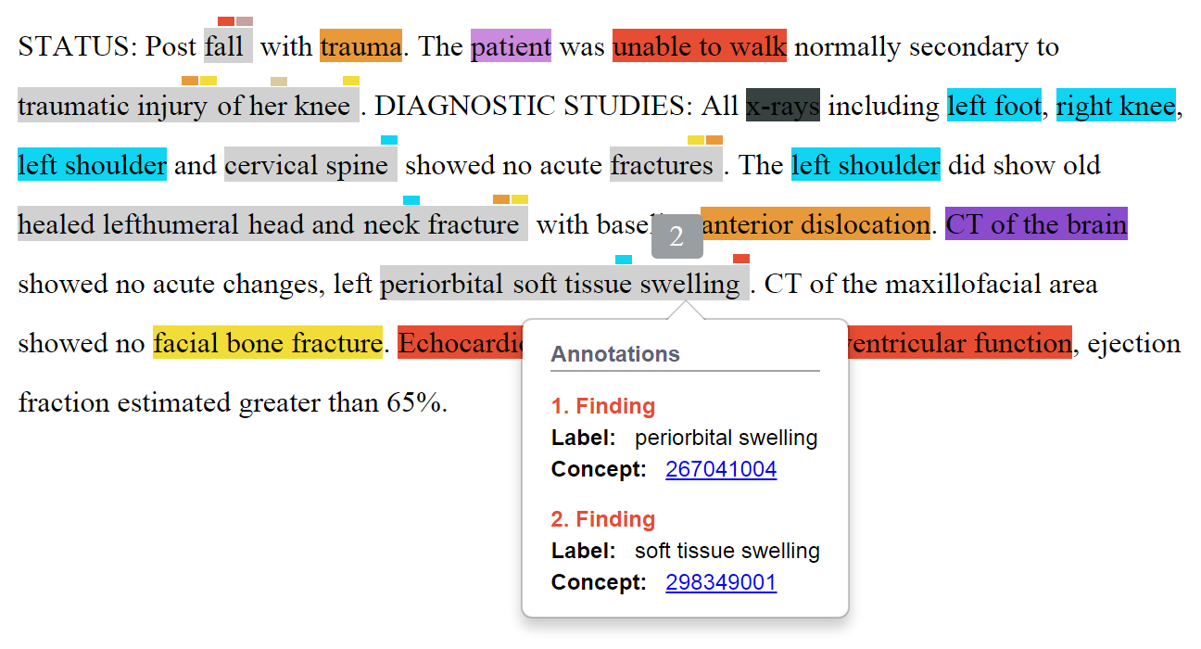
Semantic data normalization – an example

Slide 24
Fusion with Knowledge Graphs
umls:C0035204
Respiration Disorders
Chronic Obstructive Airway Diseases
broader
Bronchial Diseases
umls:C0006261
broaderTransitive
Asthma and chronic obstructive pulmonary disease (COPD) are chronic airway diseases characterized by airflow obstruction. The beta(2)-adrenoceptor mediates bronchodilatation in response to exogenous and endogenous beta-adrenoceptor agonists. Single nucleotide polymorphisms in the beta(2)-adrenoceptor gene (ADRB2) cause amino acid changes (e.g. Arg16Gly, Gln27Glu) that potentially alter receptor function. Recently, a large cohort study found no association between asthma susceptibility and beta(2)-adrenoceptor polymorphisms. In contrast, asthma phenotypes, such as asthma severity and bronchial hyperresponsiveness, have been associated with beta(2)-adrenoceptor polymorphisms.
COPD
broader
broader
broaderTransitive
Asthma
mentions
umls:C000496
mentions
journal
author
pmid:17714090
Clinical and experimental pharmacology …
Ian A Yang

Slide 25
Data Modeling
Patient XYZ
rdf:type
Patient
hasGender
male
hasBirthDate
1956/09/20 xsd:date
Data provenance: graph <http://linkedlifedata.com/resource/document/CD8672>
hasDiagnose
http://linkedlifedata.com/resource/icd9cm/157.9
rdf:type
Disease
hasStatus
current
skos:prefLabel
Malignant neoplasm of pancreas
Data provenance: graph <http://linkedlifedata.com/resource/document/CN127753>
hasTreatment
http://linkedlifedata.com/resource/treatment/DT127753
rdf:type
Treatment
hasDrug
http://linkedlifedata.com/resource/drug/irinotecan
hasDosage
180 mg/ 1 m2 for 80 min

Slide 26
Data Modeling – KB
Data provenance: graph <http://linkedlifedata.com/resource/drugBroshure/CAMPTOSAR>
http://linkedlifedata.com/resource/drugDosage/DD127753
rdf:type
Dosage
hasIndication
http://linkedlifedata.com/resource/icd9cm/157.9
hasMedication
http://linkedlifedata.com/resource/drug/irinotecan
hasPopulationGroup
Adult
hasAdministration Route
http://linkedlifedata.com/resource/route/subcutaneus
hasAdministration Form
http://linkedlifedata.com/resource/form/injection
Maximum Daily Dosage
hasDosageValue
180
hasDosageUnit
mg
hasDenominatorValue
1
hasDenominatorUnit
m2

Slide 27
Business Solution: Claim Processing Rule Library
Client: Pre-payment claims processing solution provider (US company)
Challenge: Keep up-to-date claim processing rule library built from regulatory docs
Solution: Automatic collection, extraction and validation of source data required for rule definition
Data sources used:
  Ontologies/vocabularies (ICD9/10, Snomed CT, HCPCS)
  Regulatory documents an guidelines (DailyMed, ClinicalPharmacology, DrugDex Micromedex, LCD, NCD)
Technology components:
  Ontology modelling/Knowledge graph & Information extraction
  Result: Client could automatically receive extracted information for drug dosage and experts can validate for correctness in a couple of minutes

Slide 28
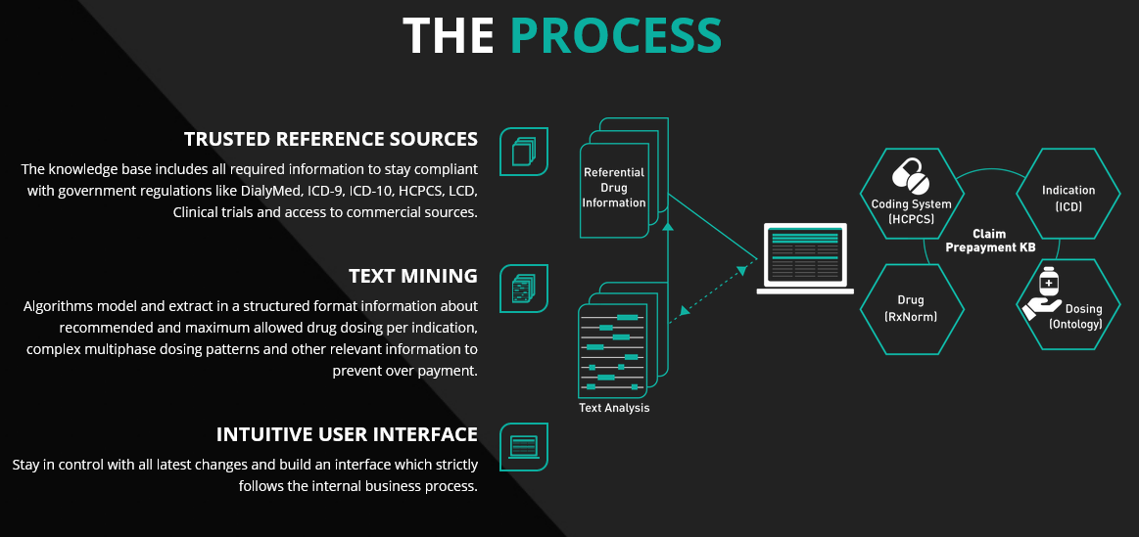

Slide 29
Business Solution: Clinical Study Mining
Client: AstraZeneca
Challenge: Answering drug product safety request from FDA takes up to 1 person-year
Solution: Semantic data integration of all structured and unstructured clinical study information and semantic indexing of associated clinical documents
Data sources used:
  Ontologies/vocabularies (MedDRA, AZDD, AZ LabCodes, GVK Gobiom, CDISC)
  Structured Clinical Data (…)
  Clinical documents (CSP, CSR, CSP-Amendments, CSR-Errata, PSUR)
Technology components:
  Ontology modelling/Knowledge graph & Information extraction & Semantic search
  Result: Collect all required for an answer data within a couple of days

Slide 30
Questions?

